Slide 1
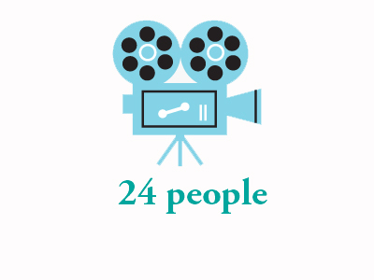

Slide 2
Outline
Objective
Existing model
Proposed Model
How application works
Features
Requirements
Entities
Future Work

Slide 3



Objective
To develop web application which acts as a bridge between a film expertise and beginners.

Slide 4
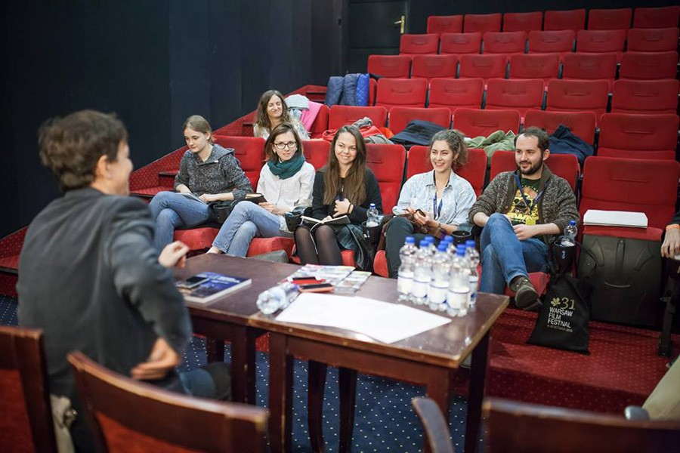
Existing model

Slide 5

Proposed Model

Slide 6




How application works

Slide 7


Features
Search for the cast and crew satisfying all your requirements.
Profile Viewing through personal information and related works.
Showcase the talent using videos, photos and multimedia.

Slide 8
Requirements
ASP.NET 5
MVC 6
EF 7
Bootstrap 3.3.6
Visual Studio 2015
Bit Bucket Repository

Slide 9
Entities used in application
Login
Director
Register
Actress
Cameraman
Actor
Producer

Slide 10
Demo

Slide 11
Future Work
All profiles with multiple Professions
Uploading videos and photos.
Feedback and ratings.
Retrieving data from all entities.

Slide 12
Thank You

